Slide 1
animon.sys
hade | choy | aquino

Slide 2
software features
Animon.sys has three main menus:
Self Service
PeopleTools
My Personalizations
PeopleTools and My Personalizations are menus that are not used by the primary users, the students
Enrollment Dates
My Class Schedule
My Weekly Schedule
Enrollment: Add Classes
Enrollment: Drop Classes
Enrollment: Swap Classes

Slide 3
database design
specifics on WHICH DATA will be stored, and how

Slide 4
student
student_id {PK} | last_name | first_name | birth_date
11327278 | Hade | Alden Luc | 1996-12-04
11337974 | Aquino | Kurt Neil | 1996-09-28
11313803 | Choy | Matthew Seaver | 1996-01-28
10725635 | Gamab | Gabriel | 1994-02-05
email_add | course | enroll_date | to_date | status
aldsTM@gmail.com | CS-ST | 2013-04-15 | 9999-01-01 | Undergraduate
kurtaquino@yahoo.com | CS-ST | 2013-05-20 | 9999-01-01 | Undergraduate
homenycablue@yahoo.com | CS-ST | 2013-05-09 | 9999-01-01 | Undergraduate
gamabsthename@aol.com | CS-NE | 2007-02-28 | 9999-01-01 | Undergraduate

Slide 5
faculty
emp_num {PK} | dept_num {FK} | last_name | first_name
10001 | D001 | Ong | Ethel
10002 | D002 | Caronongan | Arturo
10003 | D002 | Ilao | Joel
20004 | D004 | Reyes | Tristan
email_add | hire_date | to_date
ethel.ong@dlsu.edu.ph | 2009-03-05 | 9999-01-01
arturo.caronongan@dlsu.edu.ph | 2012-10-25 | 9999-01-01
joel.ilao@dlsu.edu.ph | 2012-04-12 | 9999-01-01
tristan.reyes@dlsu.edu.ph | 2007-03-31 | 9999-01-01

Slide 6
courses
course_num {PK} | course_code | course_name | emp_num {FK}
313 | INTRODB | Introduction to Databases | 10001
3510 | INTESYS | Introduction to Intelligent Systems | 10002
2069 | DIGIDES | Digital Design | 10003
2101 | CCSCAL2 | Calculus 2 for CCS | 20004
section | sched_day | time_start | time_end | room_num | capacity | enrolled
S17 | MW | 09:45 | 10:30 | G306B | 45 | 44
S17 | MW | 11:00 | 12:30 | G207 | 45 | 41
S17 | TH | 14:30 | 16:00 | G208 | 45 | 43
S11 | TH | 12:45 | 14:15 | G210 | 45 | 34

Slide 7
transactions
transaction_num {PK} | date_stamp | time_stamp
0123-4567-8910 | 2014-03-20 | 09:45
0198-7654-3210 | 2014-03-10 | 14:00
1234-7895-6540 | 2014-03-10 | 12:00
1532-7815-0584 | 2014-04-25 | 16:00
student_id {FK} | course_num {FK} | transaction_type
11337974 | 313 | 1
11313803 | 3510 | 1
11327278 | 2069 | 3
10725635 | 3732 | 2

Slide 8
reports
different OUTPUTS that can be shown depending on user needs

Slide 9
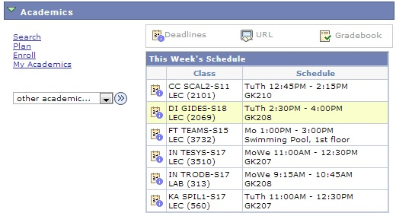
list of a student’s classes
Used by students and the university to verify student’s involvement in the class. Arranged alphabetically.

Slide 10
proposed list of students in a class
student_id {PK} | last_name | first_name
11337974 | Aquino | Kurt Neil
11313803 | Choy | Matthew Seaver
11327278 | Hade | Alden Luc
email_add | course | section
kurtaquino@yahoo.com | CCSCAL2 | S18
homenycablue@yahoo.com | CCSCAL2 | S18
aldstm@gmail.com | CCSCAL2 | S18

Slide 11
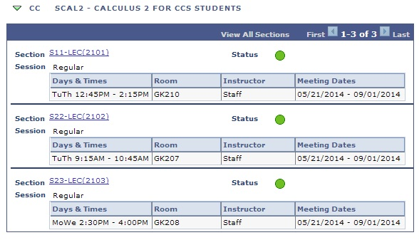
list of classes in a course
This generates the classes that can be enrolled in a specific course.

Slide 12
proposed list of a professor’s classes
emp_no{PK} | last_name | first_name | course_num {FK} | course_code | section
00001 | Ong | Ethel | 313 | INTRODB | S18
00001 | Ong | Ethel | 313 | INTRODB | S17
00001 | Ong | Ethel | 313 | INTRODB | S15
Used to SEE WORKLOAD
see which professors are overloaded or underloaded.

Slide 13
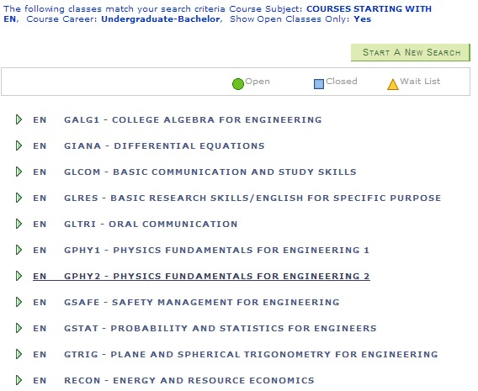
list of courses

Slide 14
proposed list of all available classes in a course
Which courses are still available?
course_code | section | slots left | room_num | time_start | time_end | sched_day
INTRODB | S18 | 2 | G206 | 09:15 | 10:45 | MW
INTRODB | S18 | 10 | G206 | 11:00 | 12:30 | TH

